Slide 1
Coffee spoon Website Design
Jana Nozickova

Slide 2
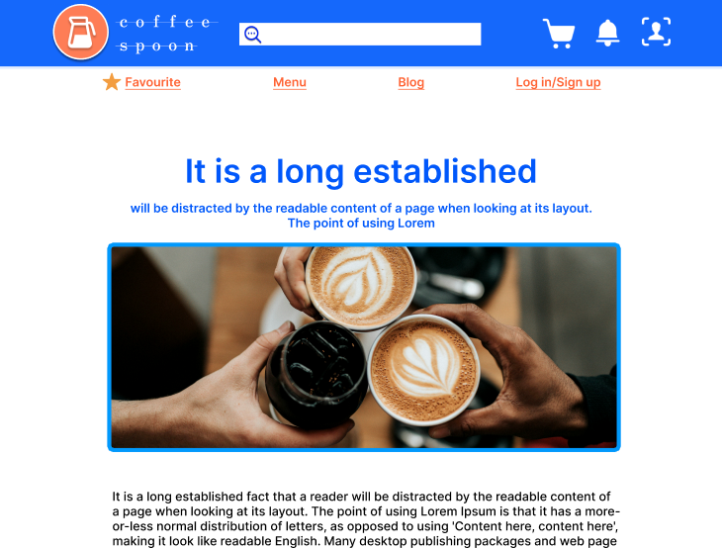
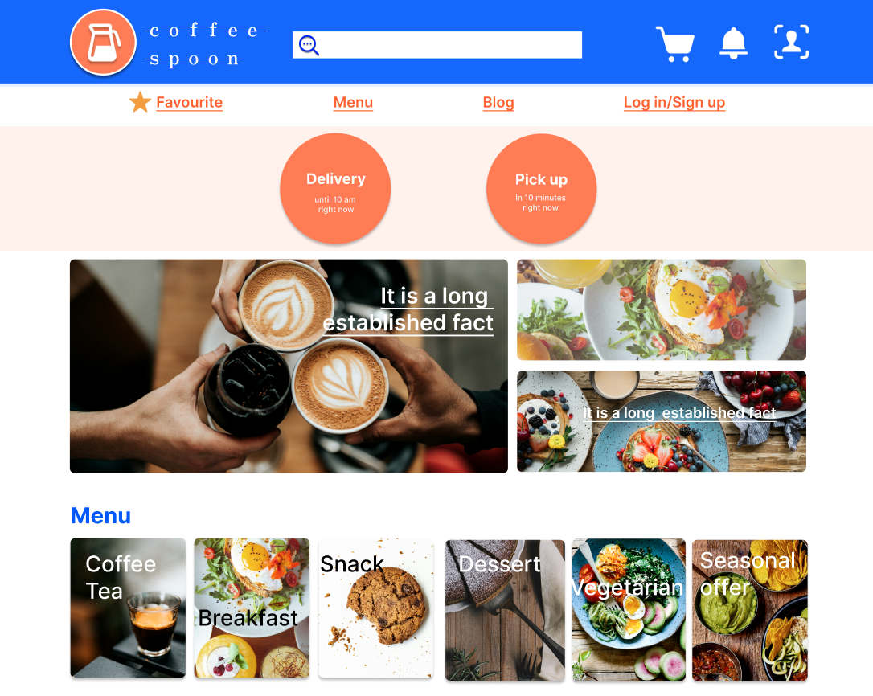
Project overview
The product:
Coffee spoon is a café, where drink and food are offered and sold. The product is about creating menu, quick and easy order from a café. There is a wide scale of users, who likes cafe menu, coffee and food. The typical user is between 18-50 years old, a busy manager or a student.
Project duration:
1 / 2024 - 2 / 2024

Slide 3
Project overview
The problem:
Solving ordering system to be quick, simple design, reliable and consider disabilities. Next thing is a menu, which should cover food intolerances, but the offer should remain varied for all visitors.
The goal:
Design an ordering system of a cafe, which will suit for people of 18-50 years old, different genders and including disabilities. Design is going to solve menu and ordering process for a cafe providing clear navigation and fast checkout process.

Slide 4
Project overview
My role:
lead UX designer
Responsibilities:
User research, paper and digital wireframing, Lo-fi and Hi-fi prototyping, Mockups, accounting for accessibility, responsive design

Slide 5
User research
Personas
Problem statements
User journey maps
Understanding
the user

Slide 6
User research: summary
I conducted an interview to understand users and their needs. I prepared an interview questions to built empathy with users. I conducted secondary research online as well, to find out, how websites for food ordering work.
The research supported some of my assumptions, but brought many new items to include in addition, like food intolerances, different technique skills, different frustrations about menu and ordering App. The research revealed some nice-to-have challenges (e.g. a seasonal offer or favorite items).

Slide 7
User research: pain points
1
2
3
4
Time
Accessibility
Food intolerances
Reliable delivery
Busy people have no time to spend on preparing food.
People with disabilities are disadvantaged, as food platform has no assistive technologies.
Food platforms do not include requirements about food allergies and intolerances.
People are afraid of troubles with delivery, which is not on time, or coffee is not delivered hot.

Slide 8
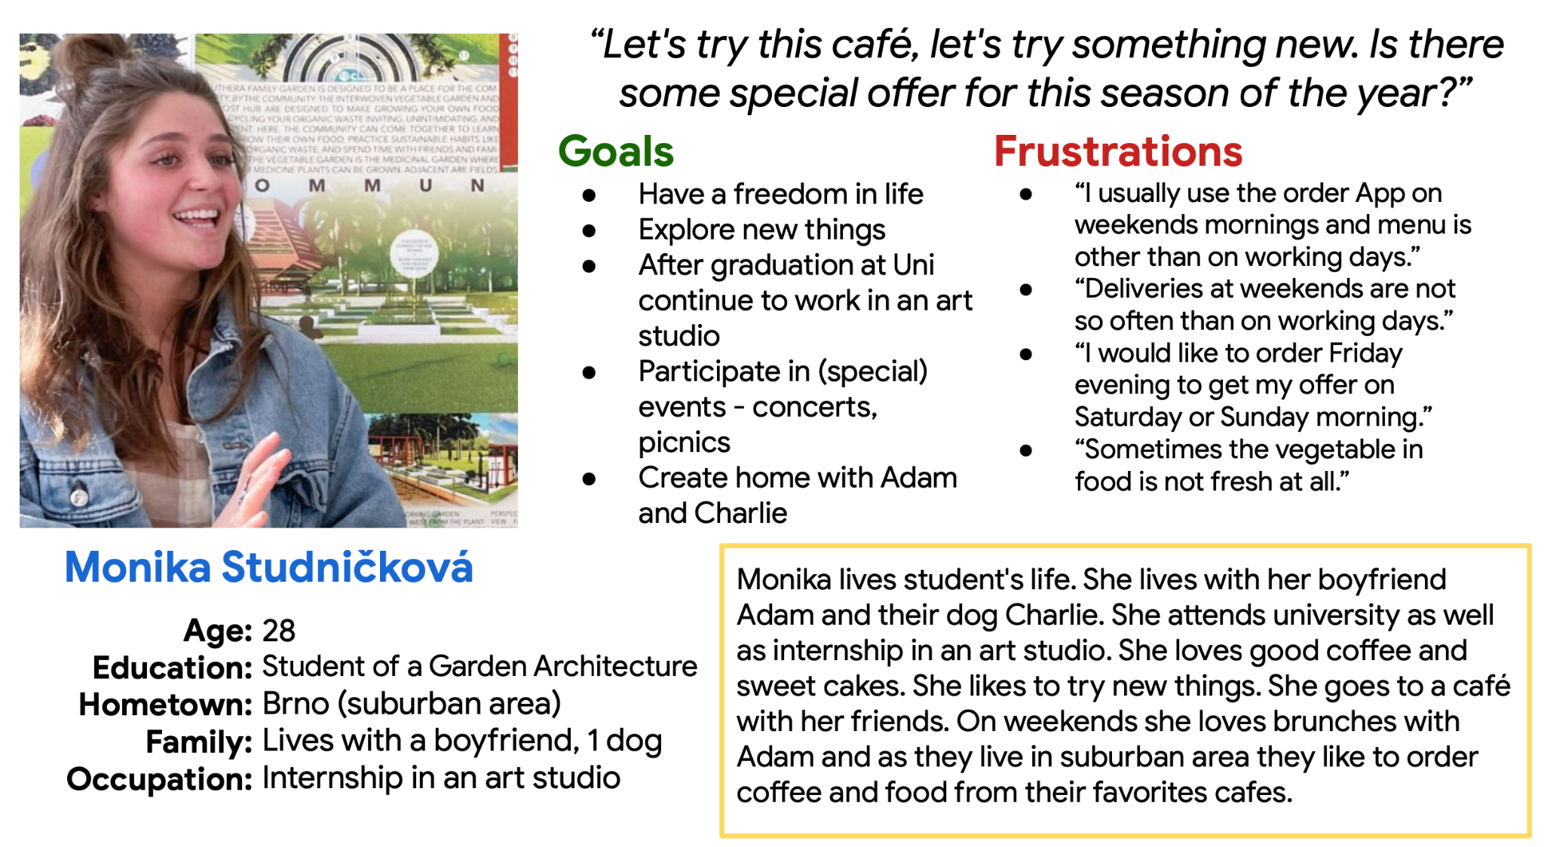
Persona: Monika Studničková
Problem statement:
Monika is a cafe lover who needs to try new things and enjoy brunch with her boyfriend or her friends because she doesn't want to cook on weekend's morning and she does not want to bother with a breakfast.

Slide 9
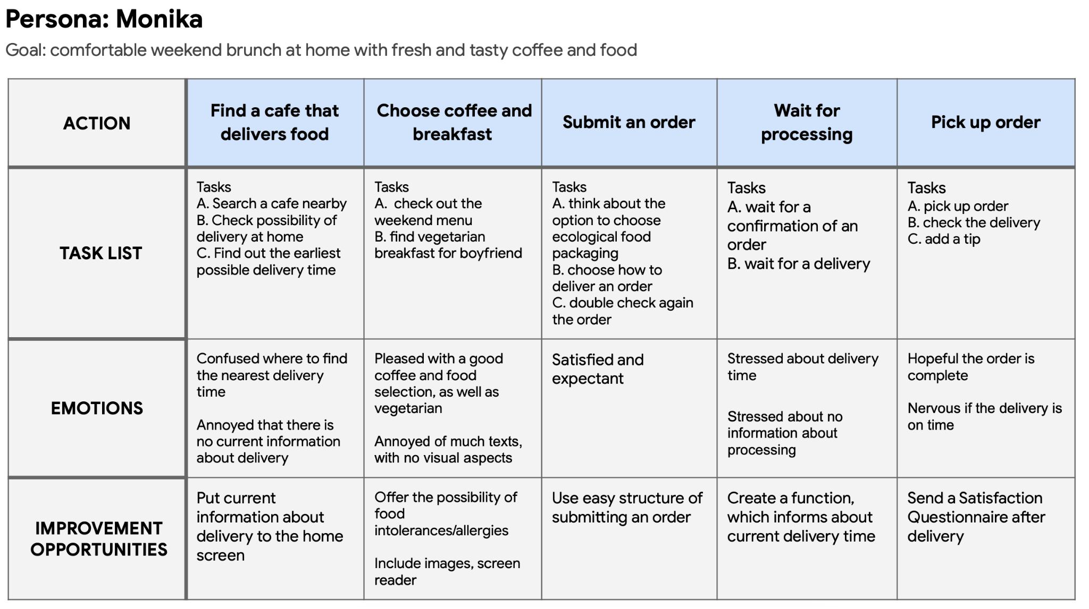
User journey map
Mapping Monika's user journey, how easy and comfortable is to get a coffee and breakfast from a cafe.

Slide 10
Sitemap
Paper wireframes
Digital wireframes
Low-fidelity prototype
Usability studies
Starting
the design

Slide 11
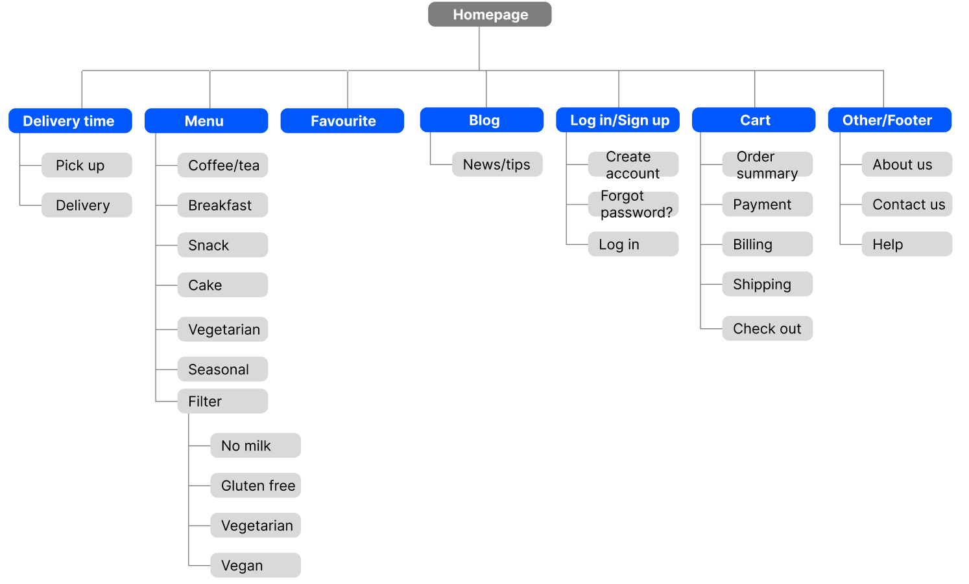
Sitemap
My goal was to make information architecture, which connect all the screens with the overall content, where the navigation is easy and clear.
I used hierarchical structure, which places content on the top of the site and helps with navigation

Slide 12
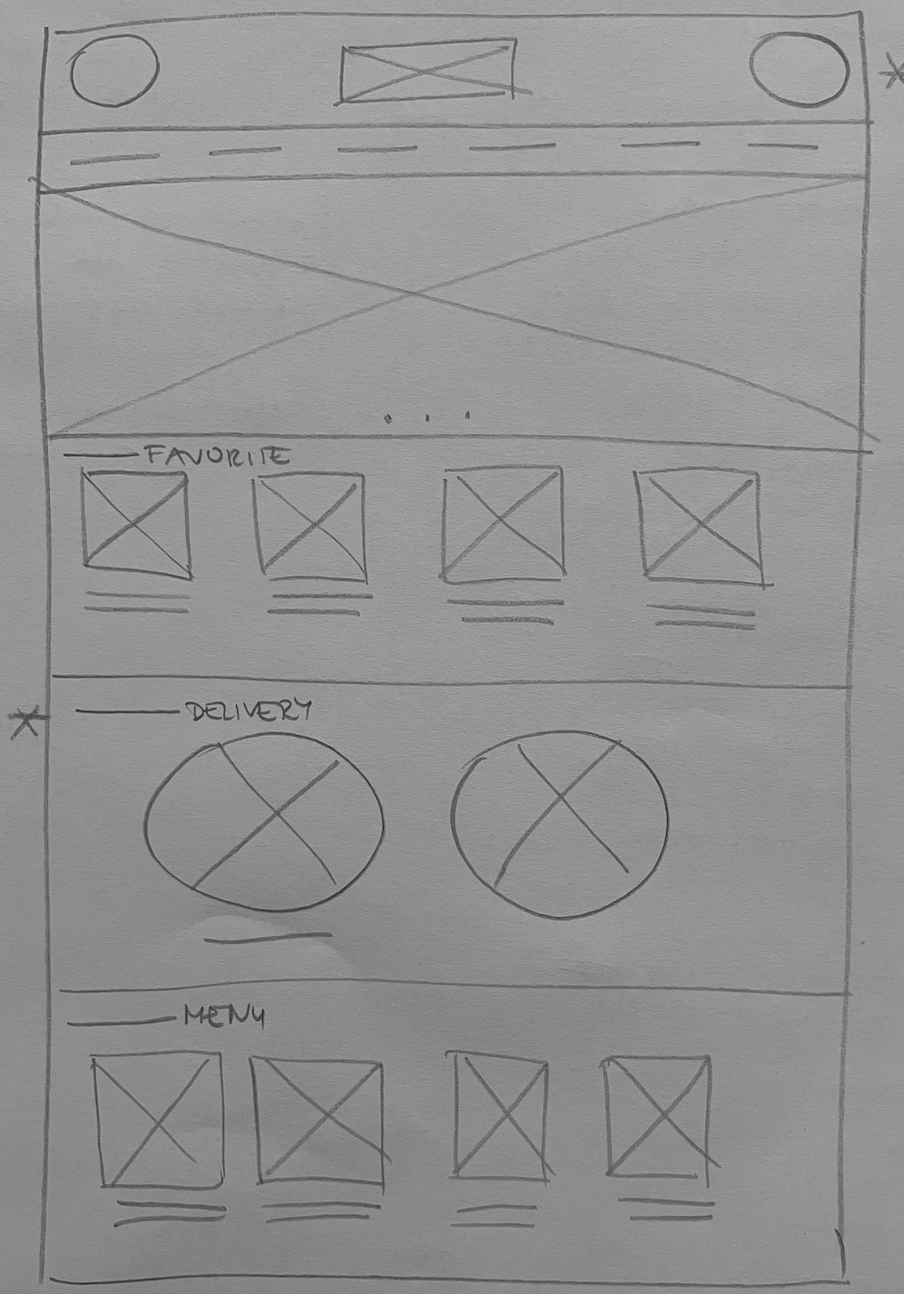
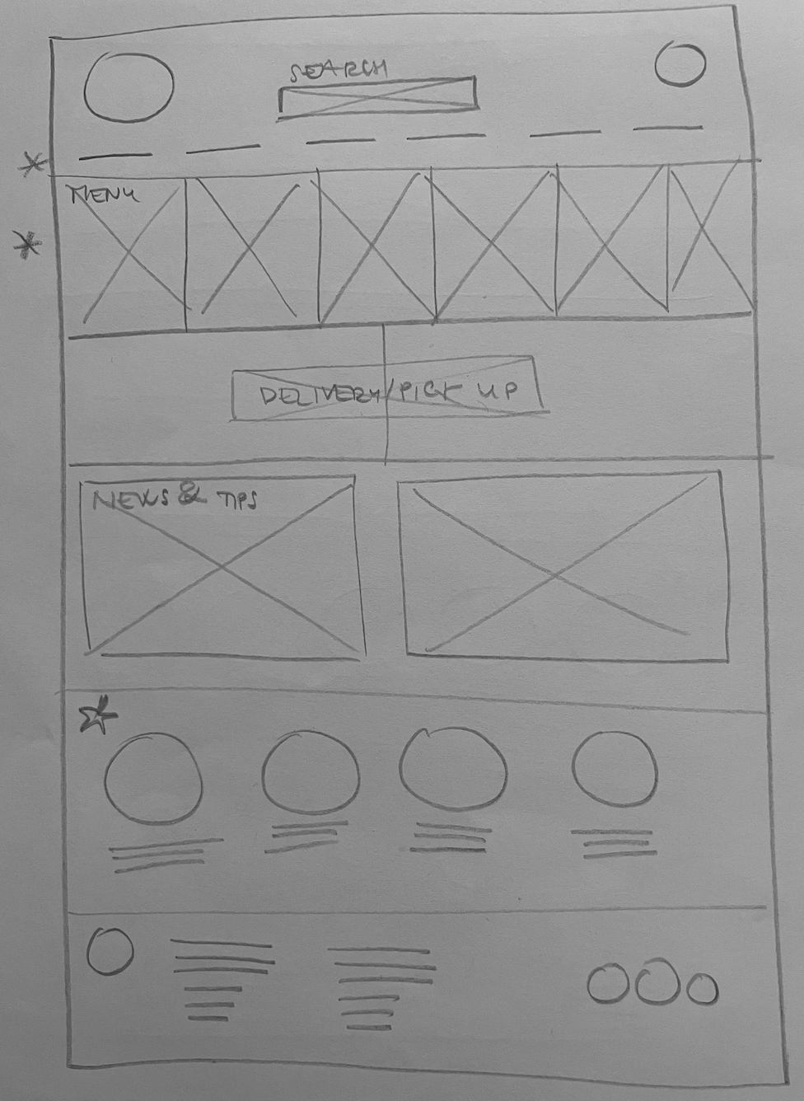
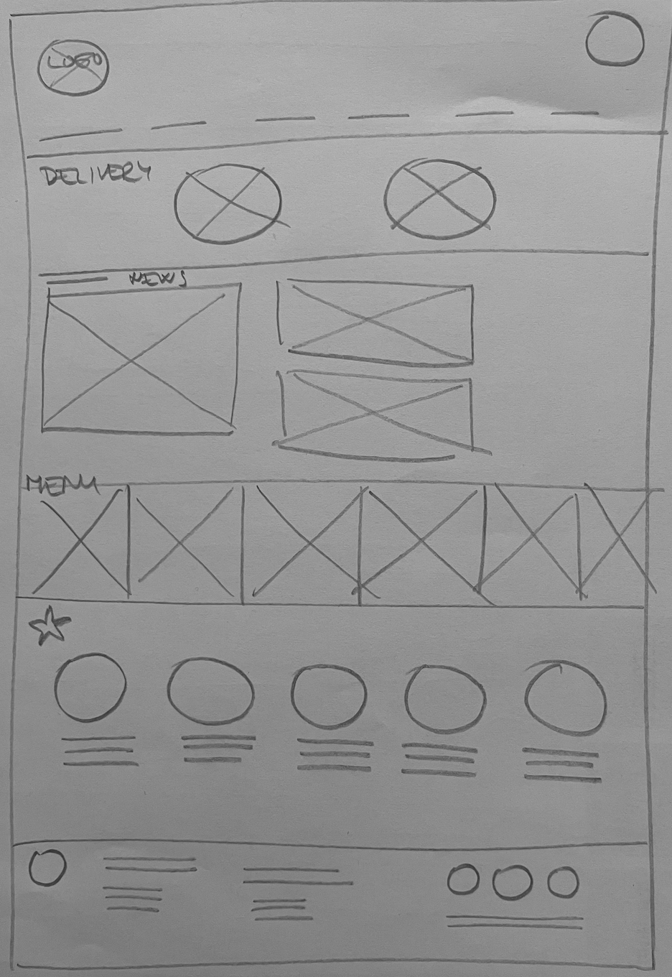
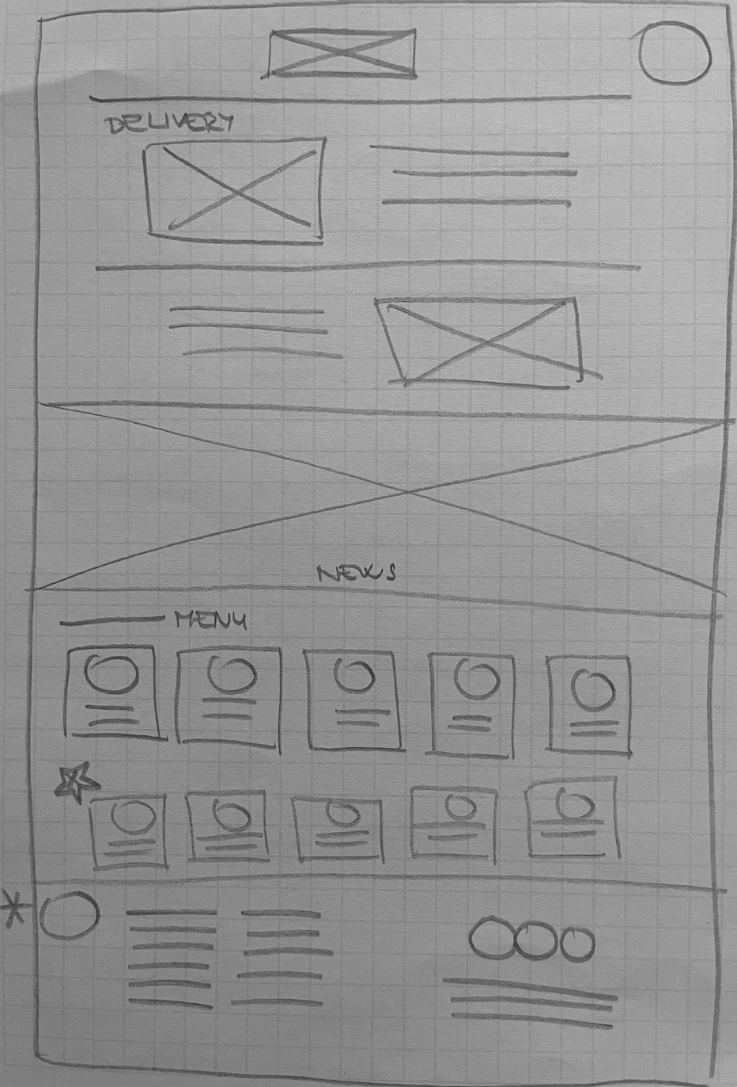
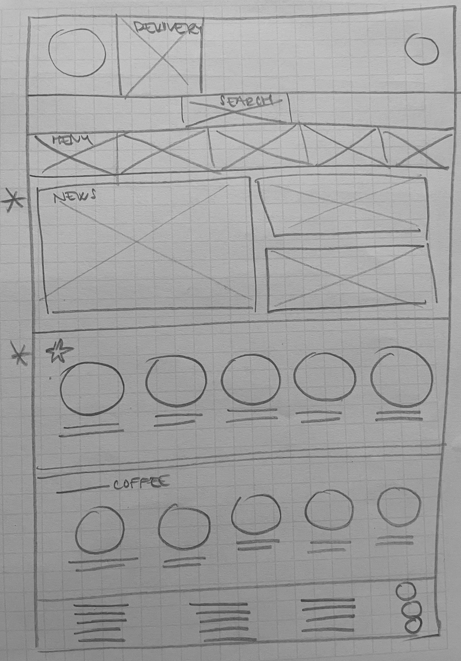
Paper wireframes
I made paper wireframes, which ensure that the elements that made it to digital wireframes would be well-suited to address user pain points. For the home screen, I prioritized a quick and easy ordering process to help users save time.
Refined paper wireframe

Slide 13
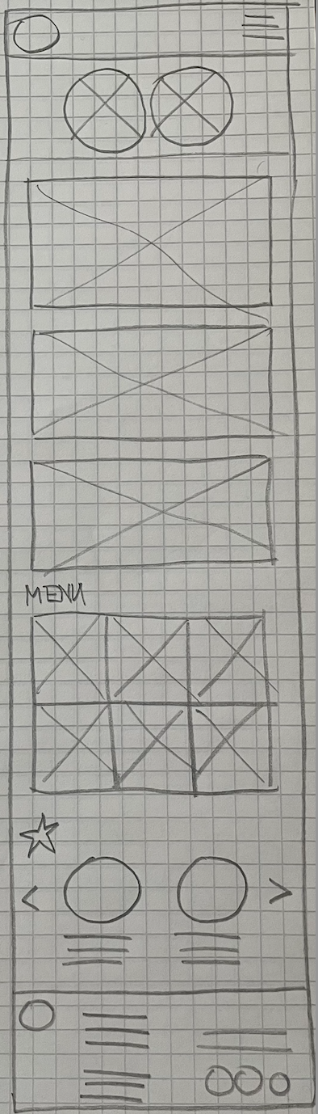
Paper wireframe
screen size variation(s)
Café customers access the site usually from both desktop and mobile device.
I started to work on designs for additional screen sizes to make sure the site would be fully responsive in different devices.
Desktop screen
Mobile screen

Slide 14
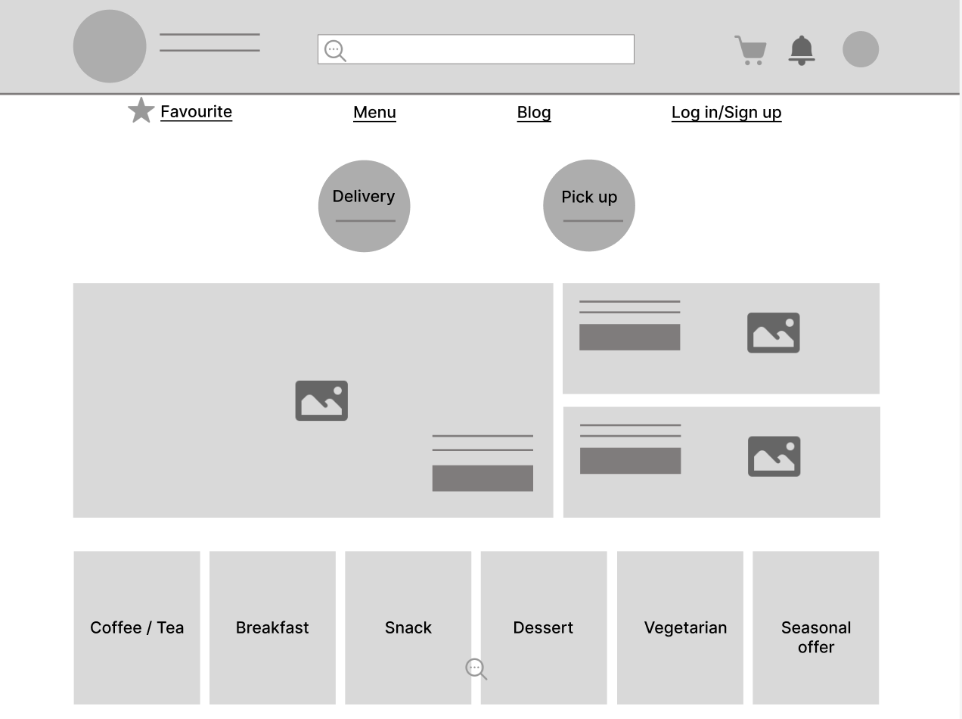
Digital wireframes
Moving from paper to digital wireframes made it easy to understand how the redesign could help address user pain points and improve the user experience.
The goal was to support easy and clear overview of menu, it was one key, user need to order coffee to office or home quickly and easily. Including assistive technology to wide range of people.
Easy access to main user flow screens
Homepage is optimazed for easy browsing, delivery option, menu and news are placed.

Slide 15
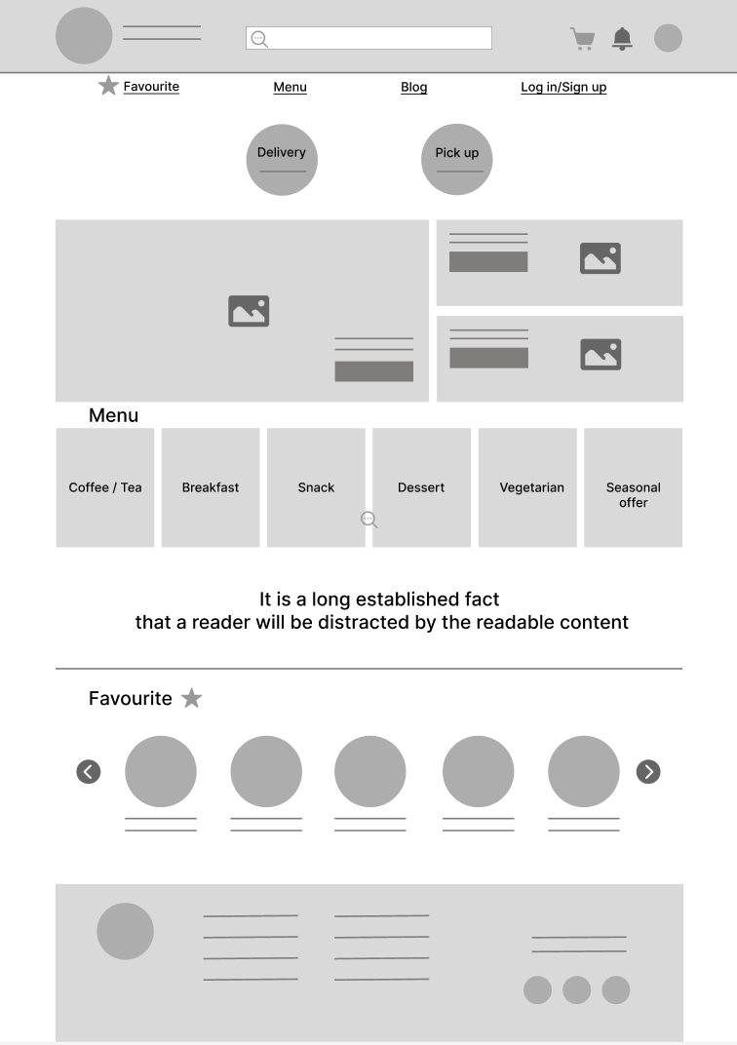
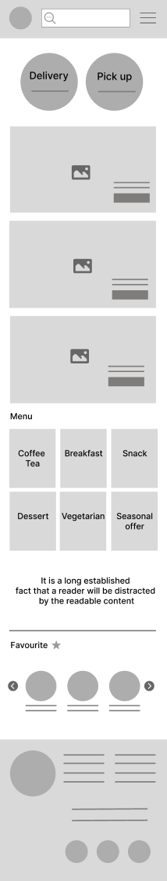
Digital wireframe screen size variation(s)

Slide 16
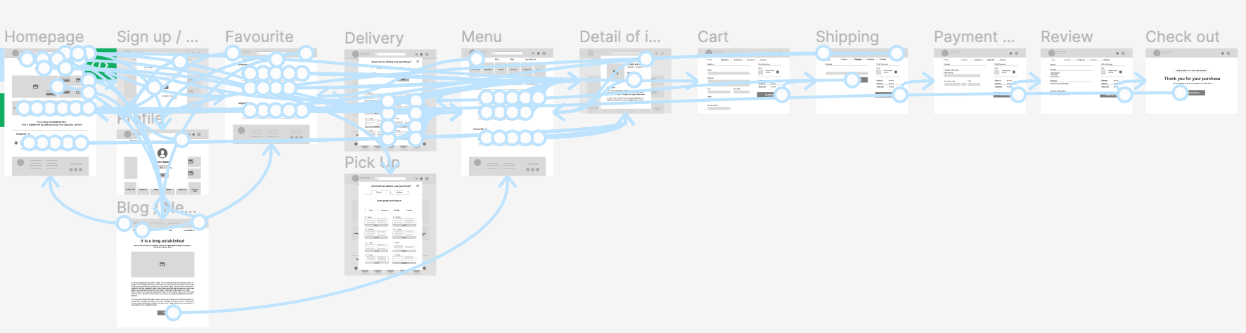
Low-fidelity prototype
I connected screens created in Lo-fi wireframes to make website interactive. User flow was tested and then user pain points could be addressed, which were very useful in next development.
View: Lo-fi prototype of Café website

Slide 17
Usability study: parameters
Study type:
Unmoderated usability study
Location:
Czech republic, remote
Participants:
5 participants
Length:
10-20 minutes

Slide 18
Usability study: findings
Insert a one to two sentence introduction to the findings shared below.
1
2
3
Profile
Detail of the product
Summary
Users like to have personal information saved in their profile, in order to use the ordering system repeatedly with no work added.
Users need smooth user flow when getting the information about the product and ordering it. In mobile screen these details were too small to get the information about product easily.
Users need to have final summary before ordering.

Slide 19
Refining
the design
Mockups
High-fidelity prototype
Accessibility

Slide 20
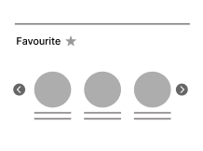
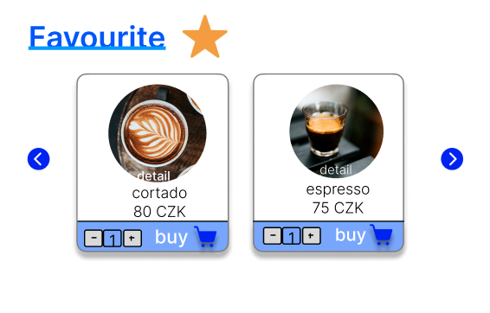
Mockups
Based on the insights from the usability study, I made changes to improve the site’s checkout flow. One of the changes I made was reducing product items in mobile app (from 3 to 2). This allowed users smoother and clear user flow.
Before usability study
After usability study

Slide 21
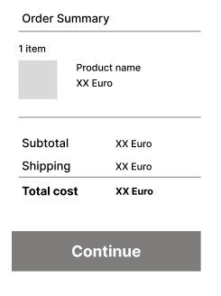
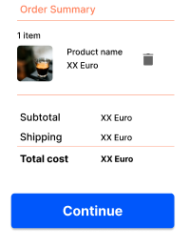
Mockups
I added delete function in Order Summary. This helps to manage the order at one place with no need to come back in the user flow.
Before usability study
After usability study

Slide 22
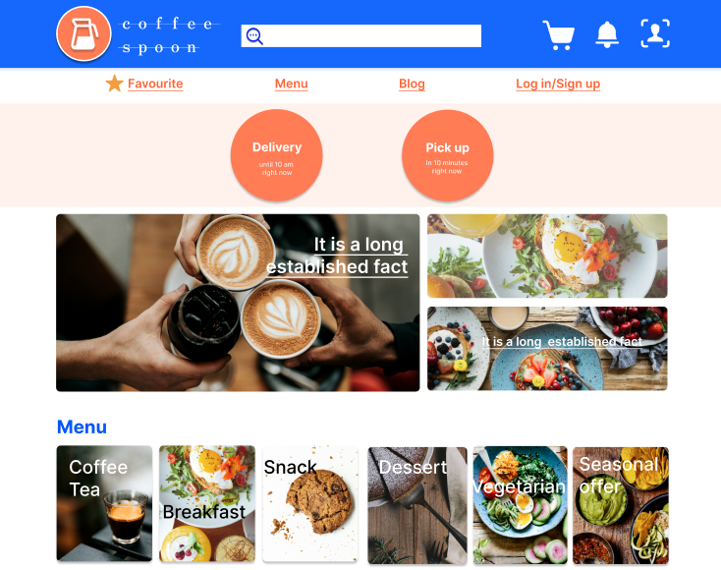
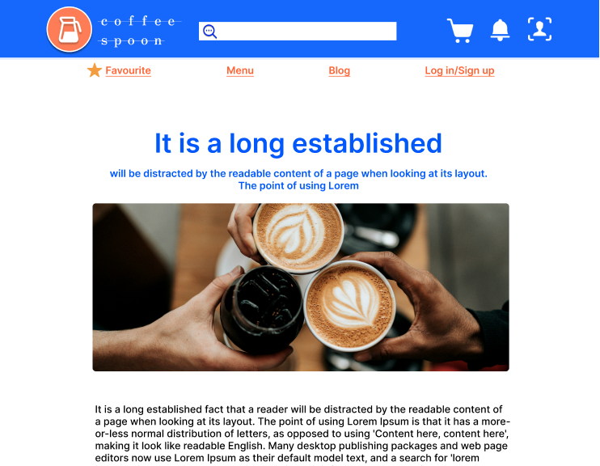
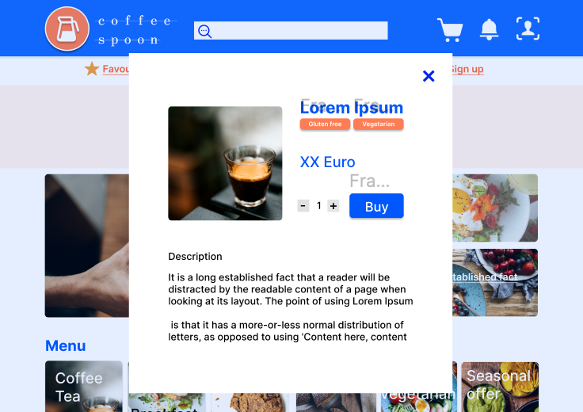
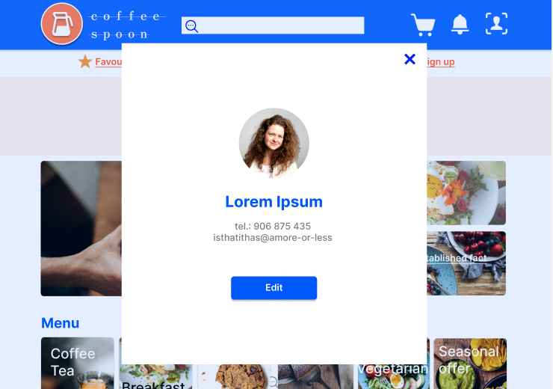
Mockups: Original screen size

Slide 23
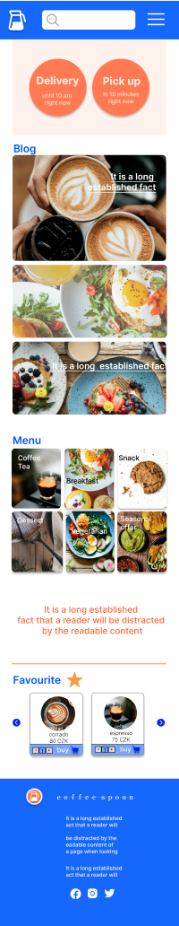
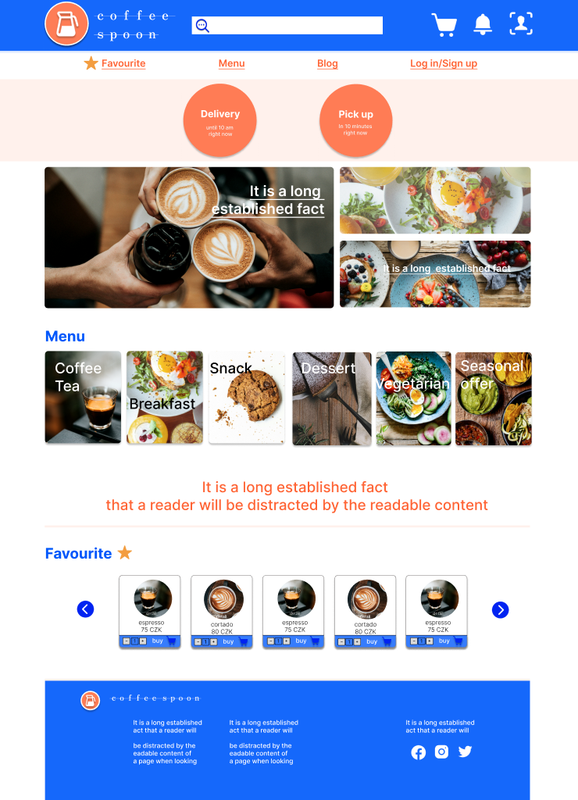
Mockups: Screen size variations
I included considerations for additional screen sizes in my mockups based on my earlier wireframes.
Because typical user is e.g. a user ordering from an office (desktop device), or whoever on its way home (mobile device), I felt it was important to optimize the browsing experience for a range of device sizes. I included desktop and mobile device so users have the smoothest experience possible.

Slide 24
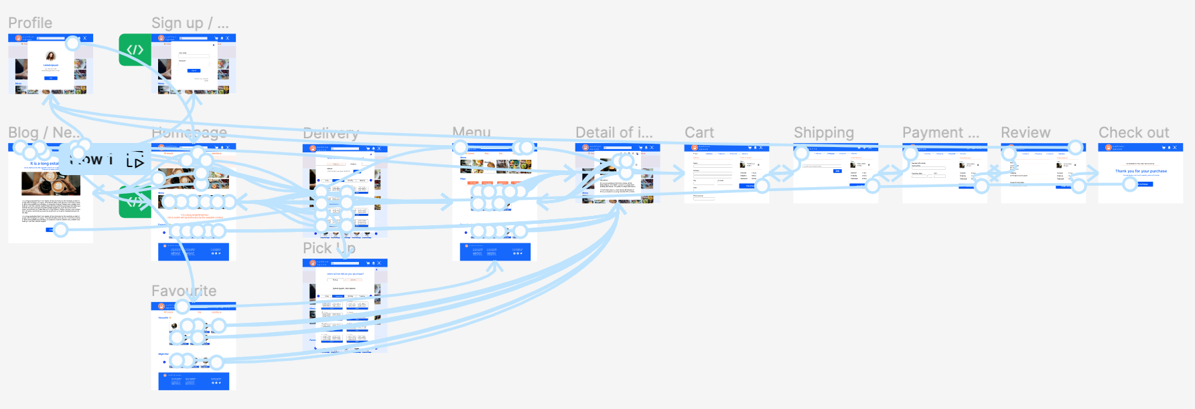
High-fidelity prototype
My hi-fi prototype followed the same user flow as the lo-fi prototype. Some changes is design were including according to usability study.
View Hi-fi prototype of Café website

Slide 25
Accessibility considerations
1
2
3
I used headings with different sized text for clear visual hierarchy
I used hierarchical model when menu and other main screens are placed on top of every screen. This supports easy user flow and visual hierarchy.
Rule 60-30-10 was applied. This added emphasis and also helps with attention to certain step-by-step order.
Blue and orange color palette was used. Blue design is both fresh and calm.

Slide 26
Going forward
Takeaways
Next steps

Slide 27
Takeaways
Impact:
This website will allow to order fast and comfortable and it doesn't matter, if it is coffee, brunch or whatever to offices or homes. In addition, it will help to organize orders in a café as well.
The information included will be up to date all the time, thanks to section “Blog/News and tips”.
What I learned:
I learned how important is to focus on the user. This real user needs help to create design ideas and solution usable, equitable, enjoyable and useful.

Slide 28
Next steps
1
2
The design process is complex, next step is to observe using the website, in case any further user needs will appear.
In case further user needs, these will be include based on usability study.
These user needs will be monitored every year.

Slide 29
Insert a few sentences summarizing the next steps you would take with this project and why. Feel free to organize next steps in a bullet point list.
Let’s connect!
Thank you for paying attention to this Café website
If you are interested, I invite you to visit my website with more ideas.PJana Nozickova
nozickovaj@gmail.com
jananozickova.cz

